Slide 1
Online Survey Berbasis Gamifikasi Menggunakan Octalysis Framework
1472005
Marlina

Slide 2


Latar Belakang
“An important aspect of games is that you never have to play them. Again, you have to go to work and you have to do your taxes. They can be awfully dreadful but you still just have to grind through them.
But with games, no one has to play them.”
- Yukai Cho
Online Survey Berbasis Gamifikasi
GAMIFIKASI
Kerja Praktek

Slide 3









Title and Content Layout with List
Kajian Teori
Add your first bullet point here
Add your second bullet point here
Add your third bullet point here
Implementasi Gamifikasi

Slide 4
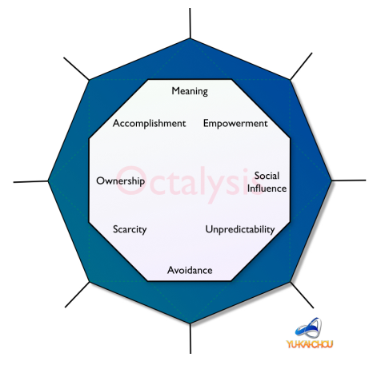

Kajian Teori

Slide 5
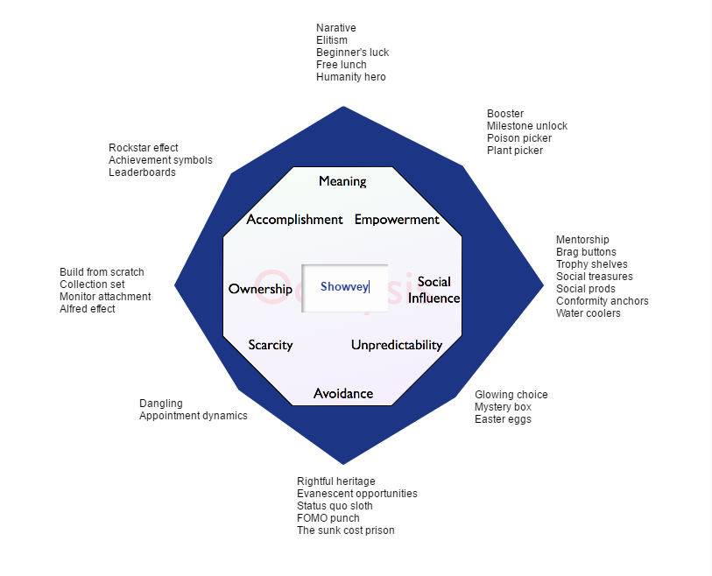
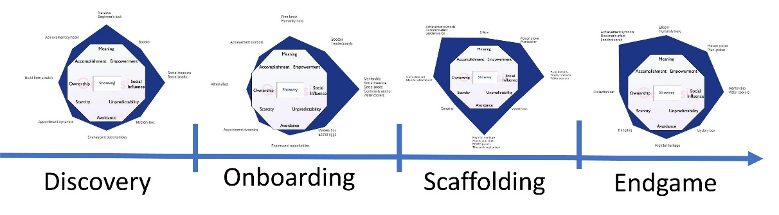
Analisis dan Rancangan Sistem

Slide 6






Fitur
Welcome’s word
Event
Chat group
Mystery box
Survey’s category
Badges

Slide 7
Thank You

